Slide 1

R Objects
Dr. Rakhee Chhibber

Slide 2
Data and Programming
R is a programming language used primarily for statistical computing and data analysis. In R, everything is an object. Here are some key concepts related to R objects, numbers, attributes, vectors, and coercion.

Slide 3
R Objects
In R, everything is an object, which means that every piece of data has a specific type and a set of properties and functions associated with it. Here are some of the common types of objects in R:
1. Numeric: Numeric objects represent numerical data, such as integers or decimal values. Numeric objects can be created using the numeric() function or by simply entering a numeric value into R.
2. Character: Character objects represent text data, such as names, words, or sentences. Character objects can be created using the character() function or by enclosing text in quotes.
3. Logical: Logical objects represent boolean values, either TRUE or FALSE. Logical objects can be created using the logical() function or by using logical operators such as ==, >, <, and &.

Slide 4

R Objects Contd..
4. Factor: Factor objects represent categorical data, such as gender, race, or color. Factors are used to store data as levels, which are mapped to integer values. Factors can be created using the factor() function.
5. Date: Date objects represent dates, such as “2022-03-25”. Date objects can be created using the as.Date() function or by using the lubridate package.
6. Time: Time objects represent times, such as “14:30:00”. Time objects can be created using the chron package or by using the lubridate package.

Slide 5
R Objects contd..
7. List: List objects are collections of objects, which can be of different types. Lists can be created using the list() function.
8. Matrix: Matrix objects are two-dimensional arrays of objects, which must be of the same type. Matrices can be created using the matrix() function.
9. Data frame: Data frame objects are similar to matrices, but can contain columns of different types. Data frames can be created using the data.frame() function.

Slide 6
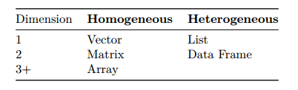
Data Structures in R
R is a powerful programming language that is commonly used for data analysis and statistical computing. It provides a number of built-in data structures that are optimized for working with data, including vectors, matrices, arrays, lists, and data frames. A data structure is either homogeneous (all elements are of the same data type) or heterogeneous (elements can be of more than one data type).

Slide 7
Data Structure in R
1. Vectors: A vector is a one-dimensional array that can hold elements of the same data type, such as numbers or characters. Vectors can be created using the c() function, which concatenates the specified values into a vector.
2. Matrices: A matrix is a two-dimensional array that can hold elements of the same data type. Matrices can be created using the matrix() function, which takes the data elements and dimensions as arguments.
3. Arrays: An array is a multi-dimensional version of a vector or matrix, which can hold elements of the same data type. Arrays can be created using the array() function, which takes the data elements, dimensions, and optionally the names of the dimensions as arguments.
4. Lists: A list is a collection of objects that can be of different types, including vectors, matrices, arrays, or even other lists. Lists can be created using the list() function, which takes the objects to be included in the list as arguments.
5. Data Frames: A data frame is a two-dimensional table-like structure, where each column can have a different data type. Data frames can be created using the data.frame() function, which takes the data elements as arguments and optionally the names of the columns.

Slide 8

Creating Vector - In R, you can create vectors using the c() function. Here are some examples:
Numeric Vector: - To create a numeric vector, use the c() function with a list of numbers separated by commas.
For example -
# creating a numeric vector
my_vector <- c(1, 2, 3, 4, 5)
2. Character Vector: - To create a character vector, use the c() function with a list of strings surrounded by quotes and separated by commas.
# creating a character vector
my_vector <- c("apple", "banana", "orange")

Slide 9
3. Logical Vector:
To create a logical vector, use the c() function with a list of TRUE/FALSE values separated by commas.
# creating a logical vector my_vector <- c(TRUE, FALSE, TRUE)
4. Factor Vector:
To create a factor vector, use the factor() function with a list of strings surrounded by quotes and separated by commas.
# creating a factor vector my_vector <- factor(c("small", "medium", "large"))

Slide 10
Numeric Sequence Vector:
To create a numeric sequence vector, use the : operator or the seq() function.
# creating a numeric sequence vector using `:` operator
my_vector <- 1:10
# creating a numeric sequence vector using `seq()` function
my_vector <- seq(from = 1, to = 10, by = 1)
These are some ways to create vectors in R. You can also combine two or more vectors using the c() function to create a new vector.

Slide 11

Vector Function
You can also use the vector() function to initialize vectors. In R, vector() is a function that creates a vector of a specified length and type. The basic syntax for using the vector() function is:
vector(mode, length)
where mode is the data type of the elements in the vector, and length is the length of the vector.
x <- vector("numeric", 5)

Slide 12

Mixing Objects
x<- c(100, "Statistics with R", TRUE) #character
y <- c(TRUE, 200) #numeric
z <- c("a", TRUE) # character
class(x)
class(y)
class(z)

Slide 13
Explicit Coercion
Explicit coercion in R refers to the process of converting a data type into another data type using a specific function or operator. Explicit coercion is also known as type casting or type conversion.
R provides various functions and operators to perform explicit coercion, including as.numeric(), as.character(), as.logical(), as.integer(), and as.factor(). These functions can be used to convert variables from one data type to another. For example, to convert a character vector to a numeric vector, the as.numeric() function can be used:
# Create a character vector
char_vec <- c("1", "2", "3")
# Convert the character vector to a numeric vector num_vec <- as.numeric(char_vec)
# Check the class of the new vector
class(num_vec)

Slide 14
2nd method of Explicit Coercion
In addition to functions, operators such as +, -, *, /, and ^ can also be used to perform explicit coercion. For example, to convert a logical vector to a numeric vector, the + operator can be used:
# Create a logical vector
logical_vec <- c(TRUE, FALSE, TRUE)
# Convert the logical vector to a numeric vector num_vec <- logical_vec + 0
# Check the class of the new vector class(num_vec)
# Output: "numeric"
It is important to note that explicit coercion may result in data loss or unexpected results if the conversion is not performed correctly. Therefore, it is recommended to use explicit coercion only when necessary and with caution

Slide 15
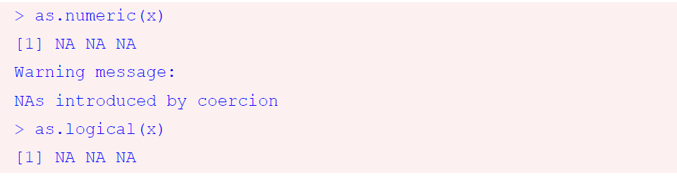
Vectors
x <- c("Statistics", "R Programming", "Python")
as.numeric(x)
as.logical(x)
Output

Slide 16

Vector based on a sequence of numbers
Method 1
y<-1:10
print(y)
Method 2
If we want to create a sequence that isn’t limited to integers and increasing by 2 at a time, we can use the seq() function.

Slide 17

Vector using rep()
Vector is rep(), which can repeat a single value a number of times.
rep("Statistics", times = 10) x<-c("Statistics","R Programming“
,"Python")
rep(x, times = 3)
length(x)

Slide 18
Subsetting
Subsetting in R involves extracting a subset of data from a larger dataset based on certain conditions or criteria. There are several ways to subset data in R, including using indexing, logical vectors, and the subset function.
Indexing: You can use indexing to extract a subset of data from a larger dataset by specifying the row and column numbers. For example, if you have a dataset called “mydata” and you want to extract the first three rows and the first two columns, you can use the following code:
mydata[1:3, 1:2]

Slide 19
2. Logical vectors: You can also use logical vectors to extract a subset of data based on certain conditions. For example, if you have a dataset called “mydata” and you want to extract all the rows where the value in the first column is greater than 5, you can use the following code:
mydata[mydata[,1] > 5, ]

Slide 20
3.The subset function: The subset function can be used to extract a subset of data based on certain conditions. For example, if you have a dataset called “mydata” and you want to extract all the rows where the value in the first column is greater than 5, you can use the following code
subset(mydata, mydata[,1] > 5)

Slide 21
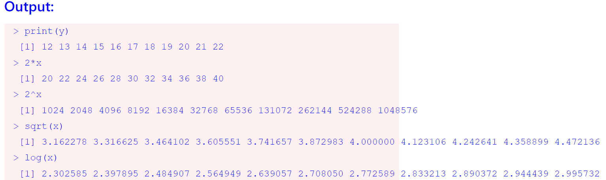
Vectorization
Vectorization is a powerful feature of R that allows for efficient manipulation and calculation of large datasets. It involves performing operations on entire vectors or matrices at once, rather than looping through each element of the data structure.
x<- 10:20
y<- x+2
print(y)
2*x
2^x
sqrt(x)
log(x)

Slide 22
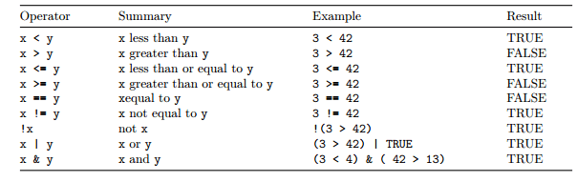
Logical Operators in R
In R, logical operators are used to create logical expressions that evaluate to either TRUE or FALSE. These operators are commonly used in conditional statements, loops, and data filtering.

Slide 23
rep() function in R
rep() is function sometimes very useful to replicate the values in x. In R, the rep() function is used to repeat a specified object or vector multiple times. The basic syntax of the rep() function is:
rep(x, times, each, length.out)
where:
x is the object or vector to be repeated.
times is the number of times to repeat x.
each is the number of times to repeat each element of x before moving to the next element.
length.out is the desired length of the output vector, which can be used as an alternative to the times argument.

Slide 24
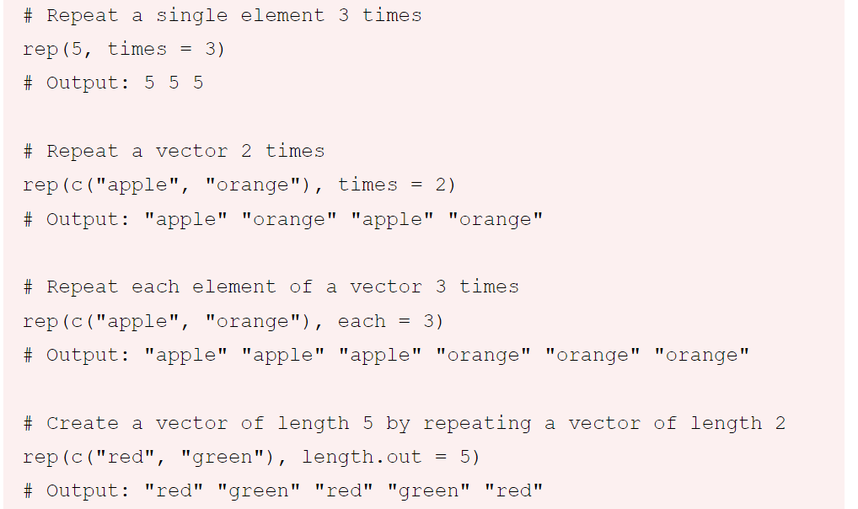

Slide 25
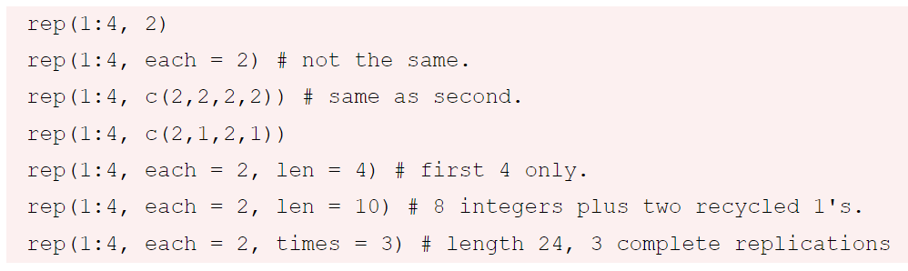
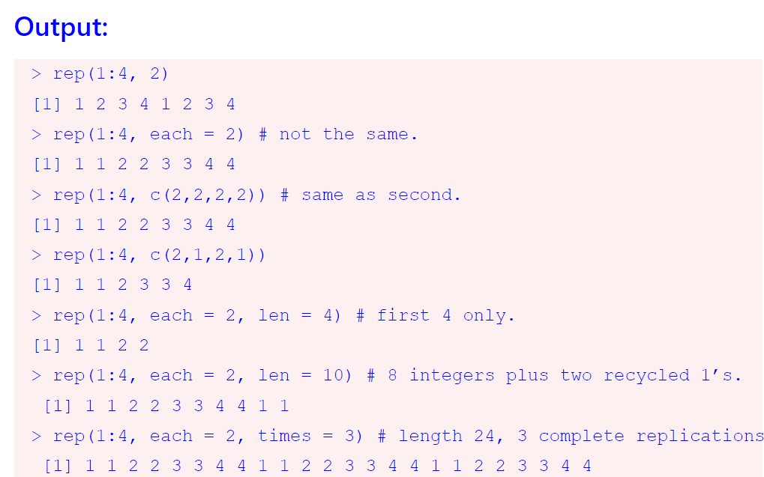

Slide 26
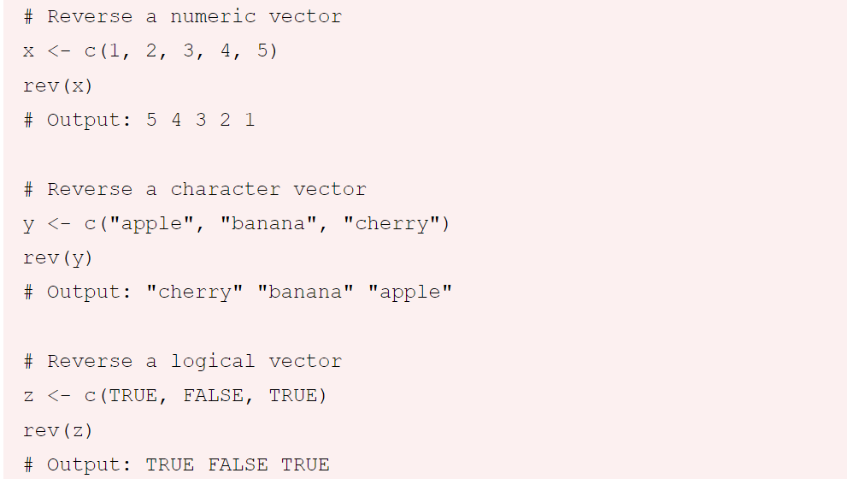
rev() function in R
In R, the rev() function is used to reverse the order of elements in a vector. The basic syntax of the rev() function is:
rev(x)
where x is the vector to be reversed.
Here are a few examples of using the rev() function:

Slide 27

Matrices, Lists, Factors
A matrix in R is a two-dimensional array of elements, all of the same data type. Matrices are created using the matrix() function and can be manipulated using various functions such as cbind(), rbind(), and diag(). Matrices are useful for performing matrix algebra and other mathematical operations on data.
m <- matrix(nrow = 2, ncol = 3)
dim(m)
attributes(m)
m <- matrix(1:20, nrow = 4, ncol = 5)
m

Slide 28
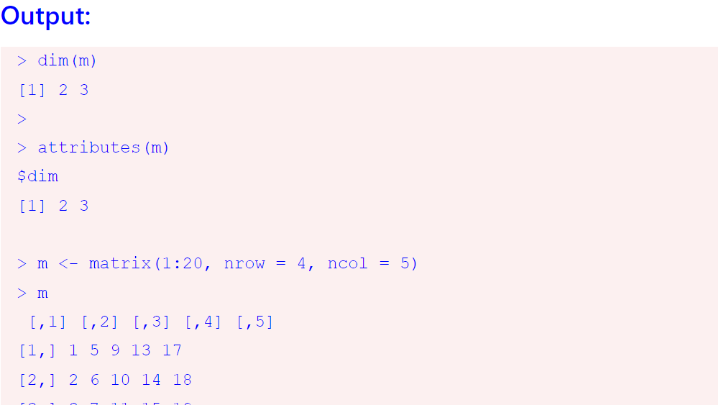

Slide 29
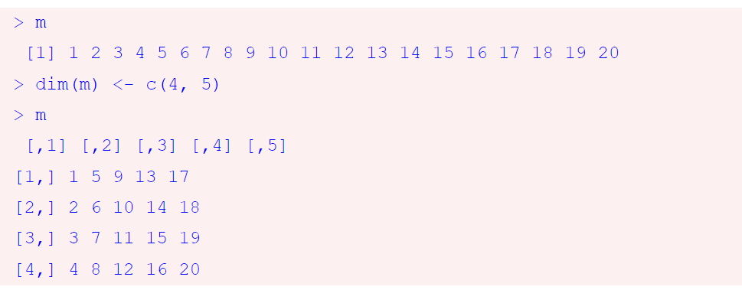
Example
m <- 1:20
m
dim(m) <- c(4, 5)
m

Slide 30
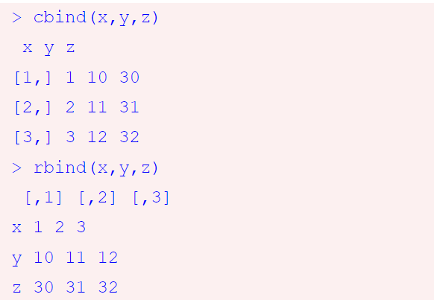
Cbind and rbind functions
Matrices can be created by column-binding or row-binding with the cbind() and rbind() functions.
x<-1:3
y<-10:12
z<-30:32
cbind(x,y,z)
rbind(x,y,z)
By default the matrix function reorders a vector into columns, but we can also tell R to use rows instead.
x <-1:9
matrix(x, nrow = 3, ncol = 3)
matrix(x, nrow = 3, ncol = 3, byrow = TRUE)

Slide 31
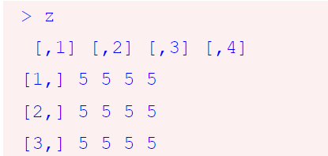
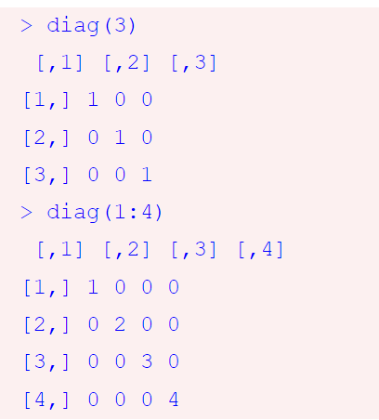
Matrics with constant value
z<- matrix(5, 3, 4)
z
We can create a matrix with specified elements on the diagonal. (And 0 on the off-diagonals.)
diag(3)
diag(1:4)

Slide 32
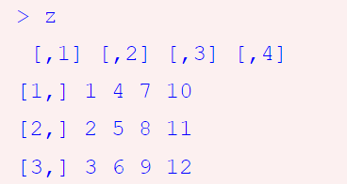


Another example
z<- matrix(1:12, 3, 4)
z
z[1, ]
z[ ,2]

Slide 33
Transpose matrix
# create a matrix
m <- matrix(c(1,2,3,4,5,6), nrow = 2, ncol = 3)
# print the matrix
m
# transpose the matrix
t(m)

Slide 34
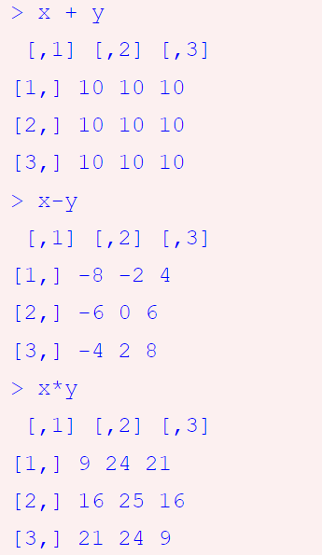
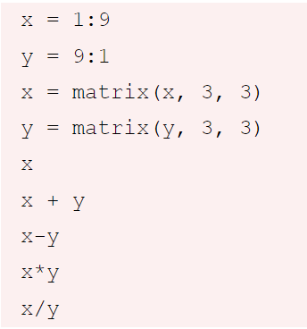
Matrix Operations

Slide 35
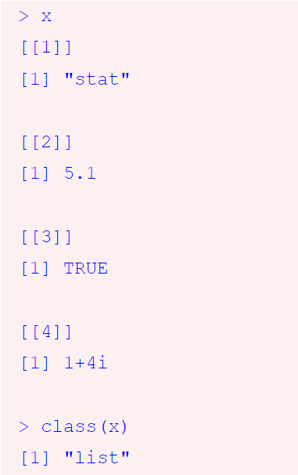
List in R
Lists are a special type of vector that can contain elements of different classes. So, a list in R is a collection of objects, which can be of different data types. Lists are created using the list() function and can be accessed using the double bracket [[ ]] or single bracket [ ] notation. Lists are useful for organizing data and creating complex data structures.
x <- list("stat",5.1, TRUE, 1 + 4i)
x
class(x)

Slide 36
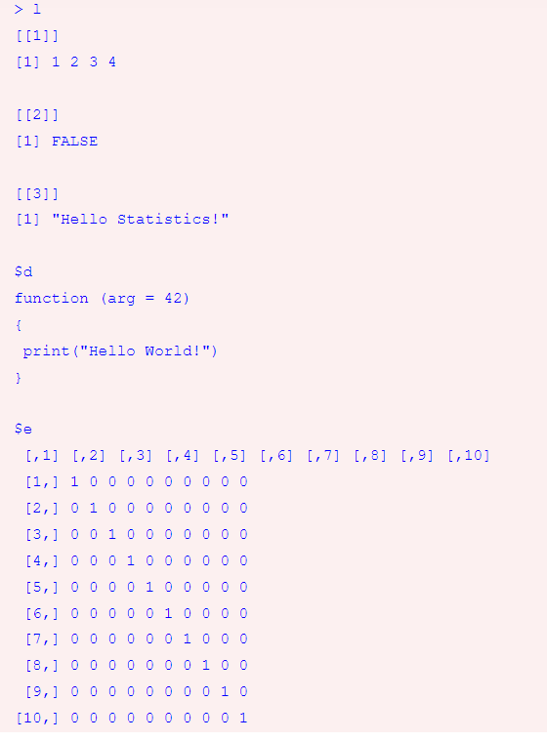
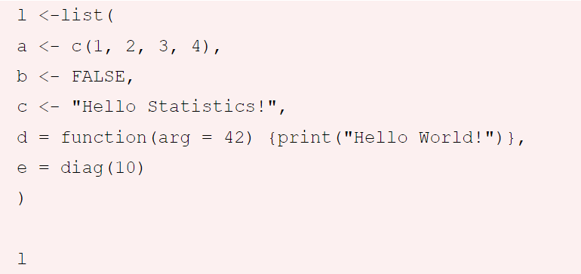
Complex Lists

Slide 37
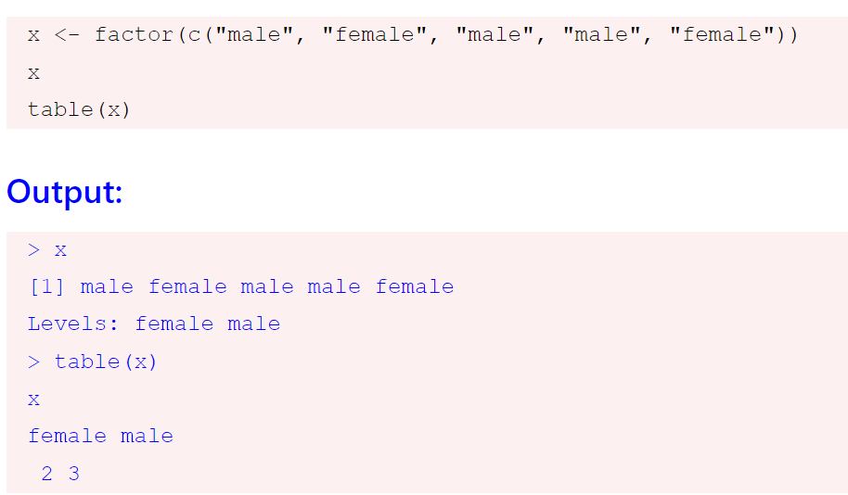
Factor to represent categorical data- table() function

Slide 38
Data Frames in R
Data frames can be created using the data.frame() function in R. You can also read in data from external files, such as CSV or Excel files, and convert them into data frames using functions like read.csv() or read_excel() from the tidyverse package. Once you have a data frame, you can manipulate and analyze the data using functions like subset(), aggregate(), and merge().

Slide 39
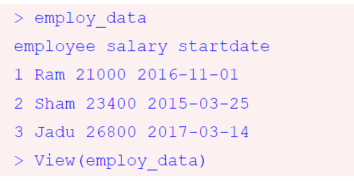
Example
employee <- c('Ram','Sham','Jadu’)
salary <- c(21000, 23400, 26800)
startdate <- as.Date(c('2016-11-1','2015-3-25','2017-3-14’))
employ_data <- data.frame(employee, salary, startdate)
employ_data
View(employ_data)

Slide 40
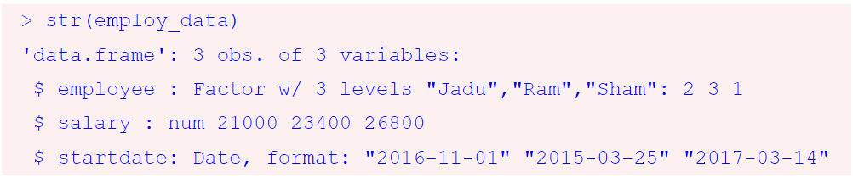
str Function
str(employ_data)

Slide 41
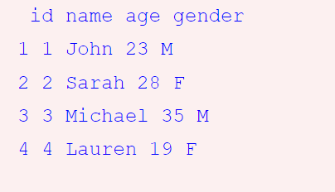
Reading data from .csv file
# Read in a CSV file
mydata <- read.csv("mydata.csv")
# Convert the data to a data frame
df <- data.frame(mydata)
# Print the data frame
df

Slide 42
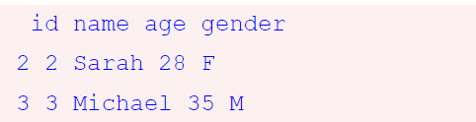
Subsetting a data frame:
# Subset the data frame to include only rows where age is greater than 25
subset_df <- subset(df, age > 25)
# Print the subsetted data frame
subset_df

Slide 43

Thank You

